Slide 1
Letus plant
2
+
2
+
ITQ – smart green BIO

Slide 2
Transparency ? Sustainability ? Story ?
2
+
2
+
Problem Statement

Slide 3
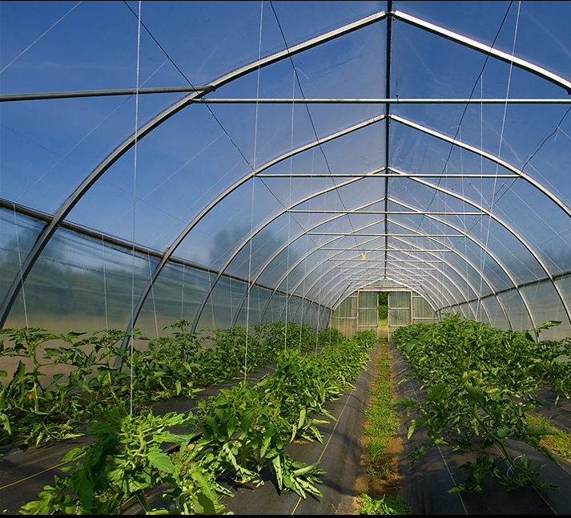
Existing Technology

Slide 4
Aims
Guiding Principles
Social: Improve trust, transparency, and engagement in the story of food.
Environment: Improve the resilience of urban cities by enhanced food security.
Technology: Engage a new section of society into a food production by breaking down barriers of entry.

Slide 5
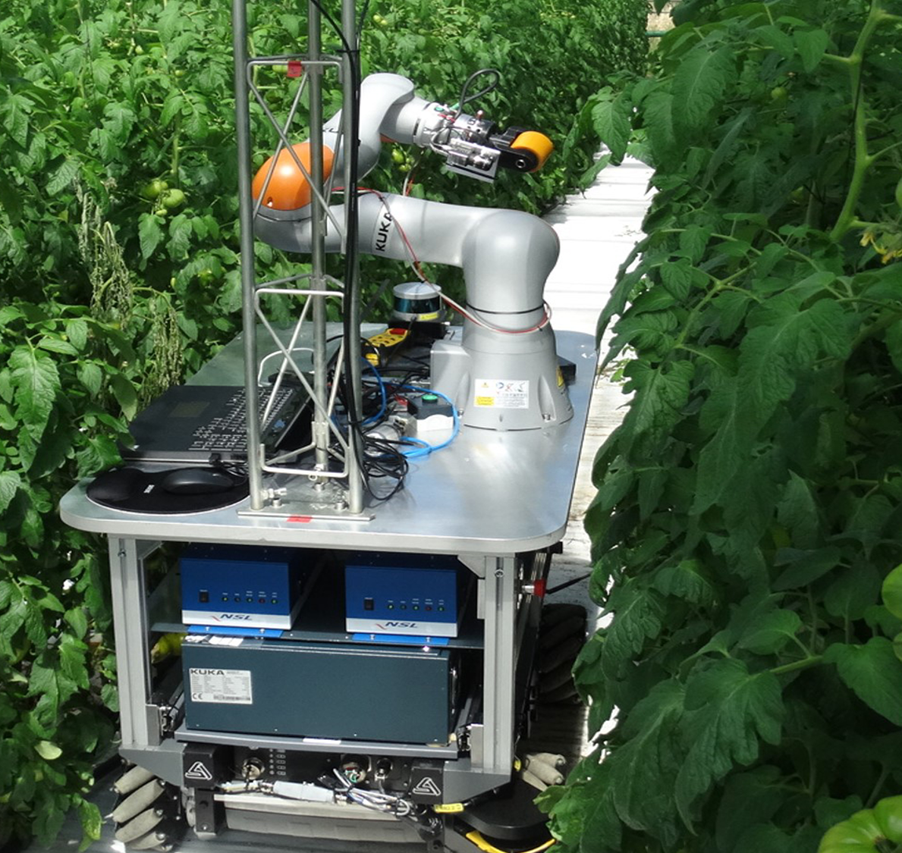
Hardware + Software
Hardware
Software

Slide 6
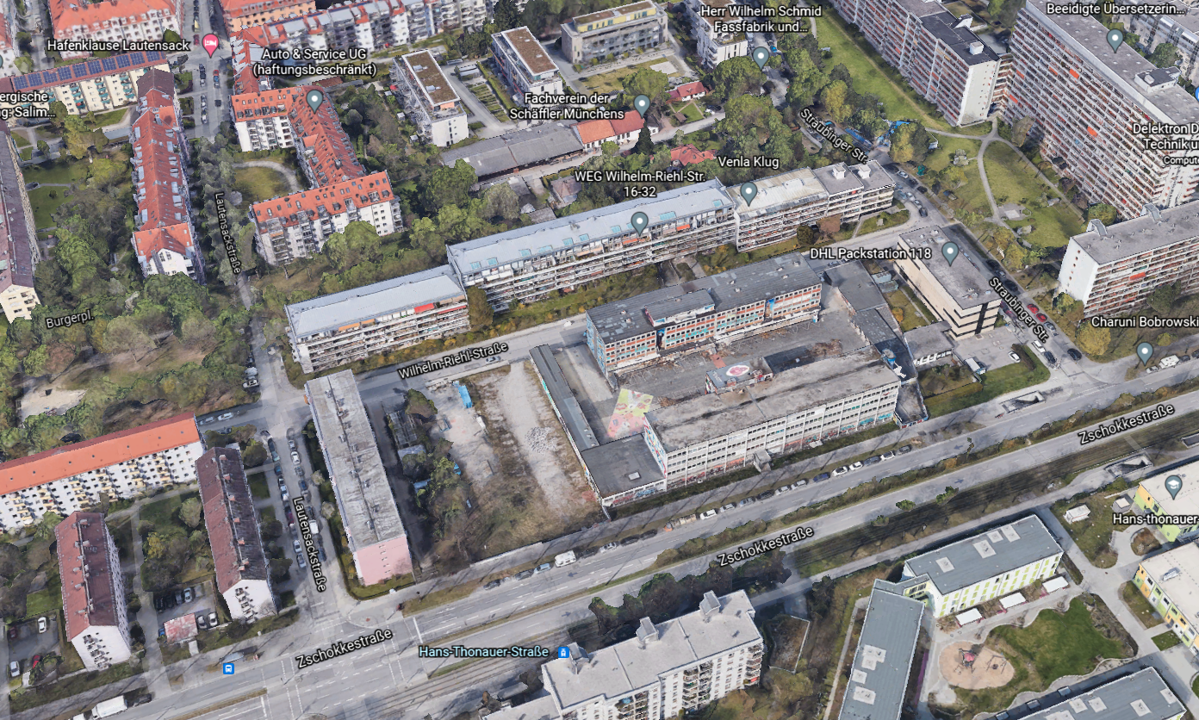
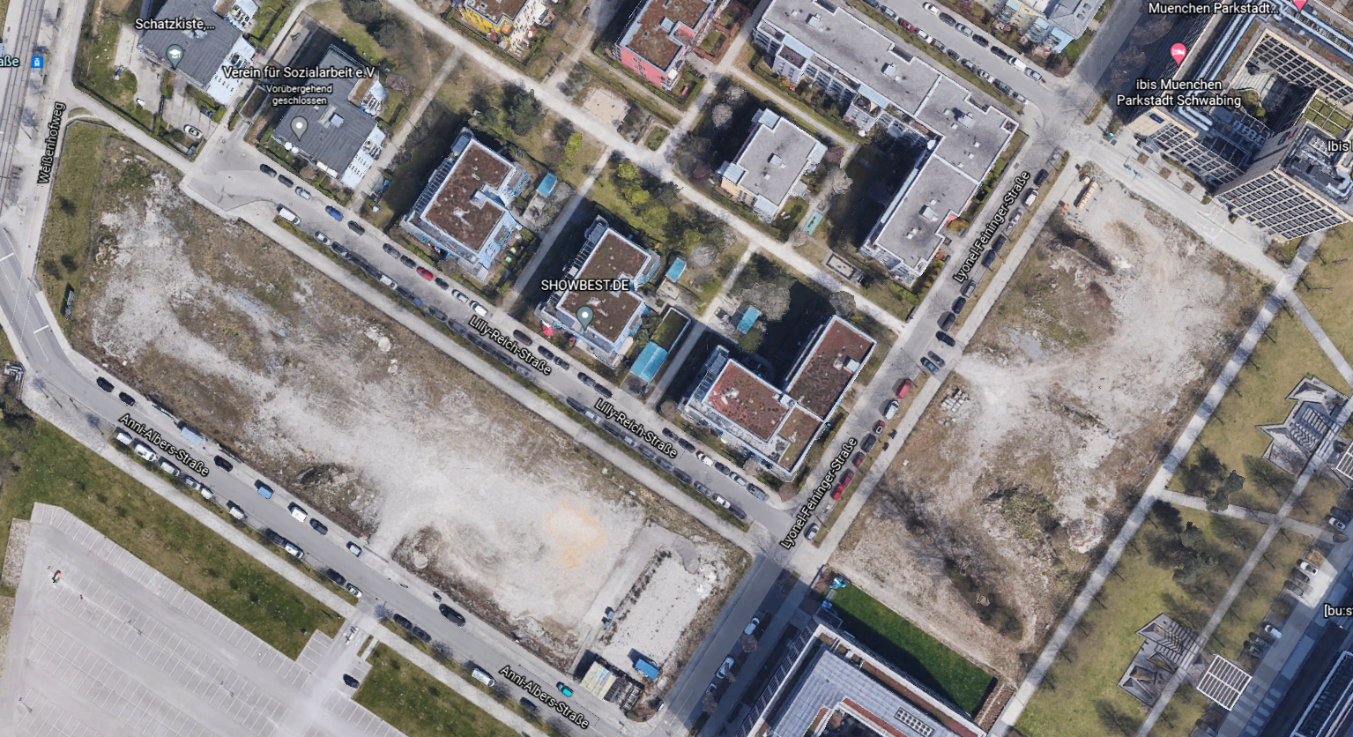
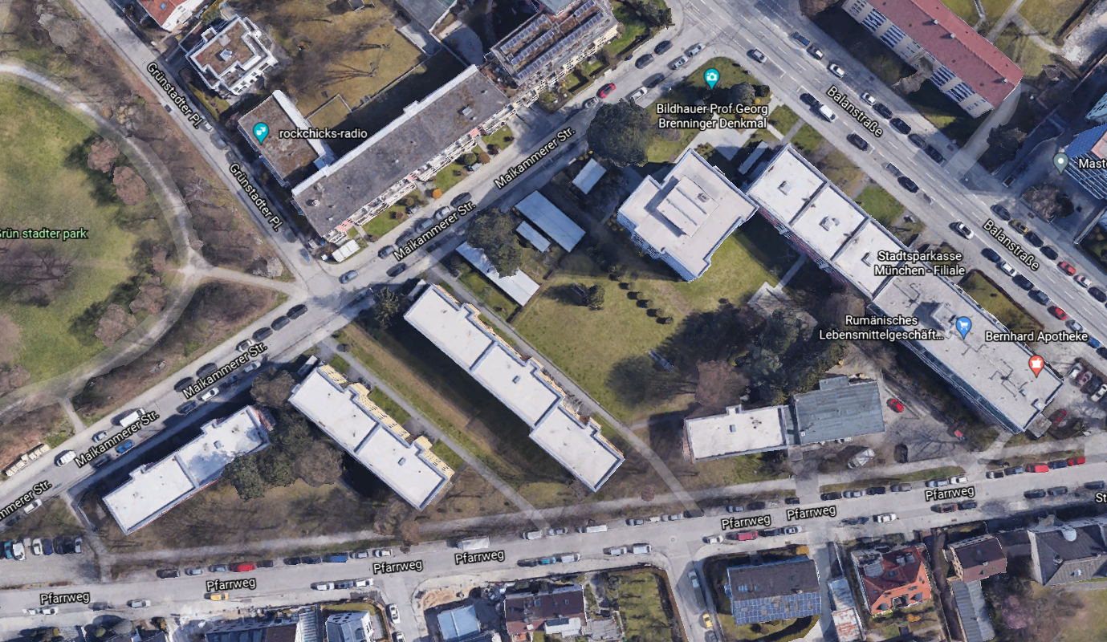
Research
2
+

Slide 7
Literature Review – Hypothesis Validation
2
+
(Doernberg, Horn, Zasada and Piorr, 2019)
(Sindlinger, 2020)
(Schweitzer, 2021)

Slide 8
Inspiration
2
+

Slide 9
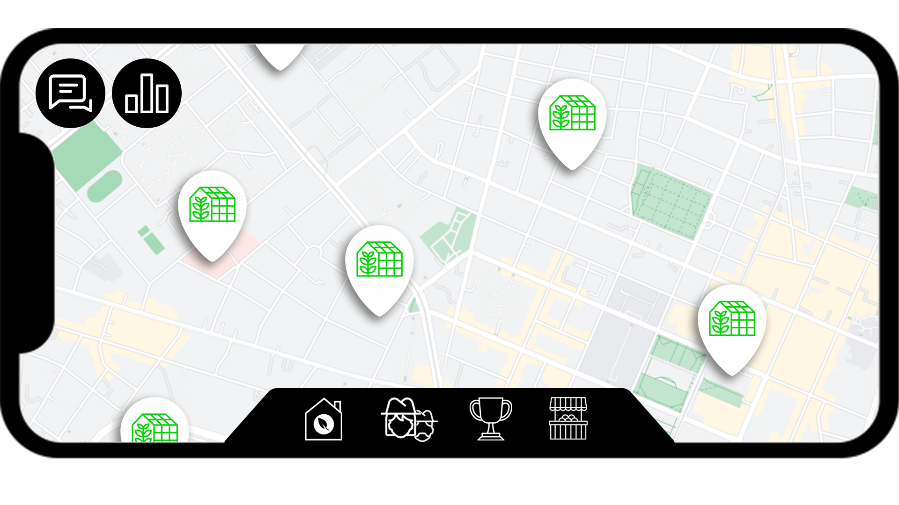
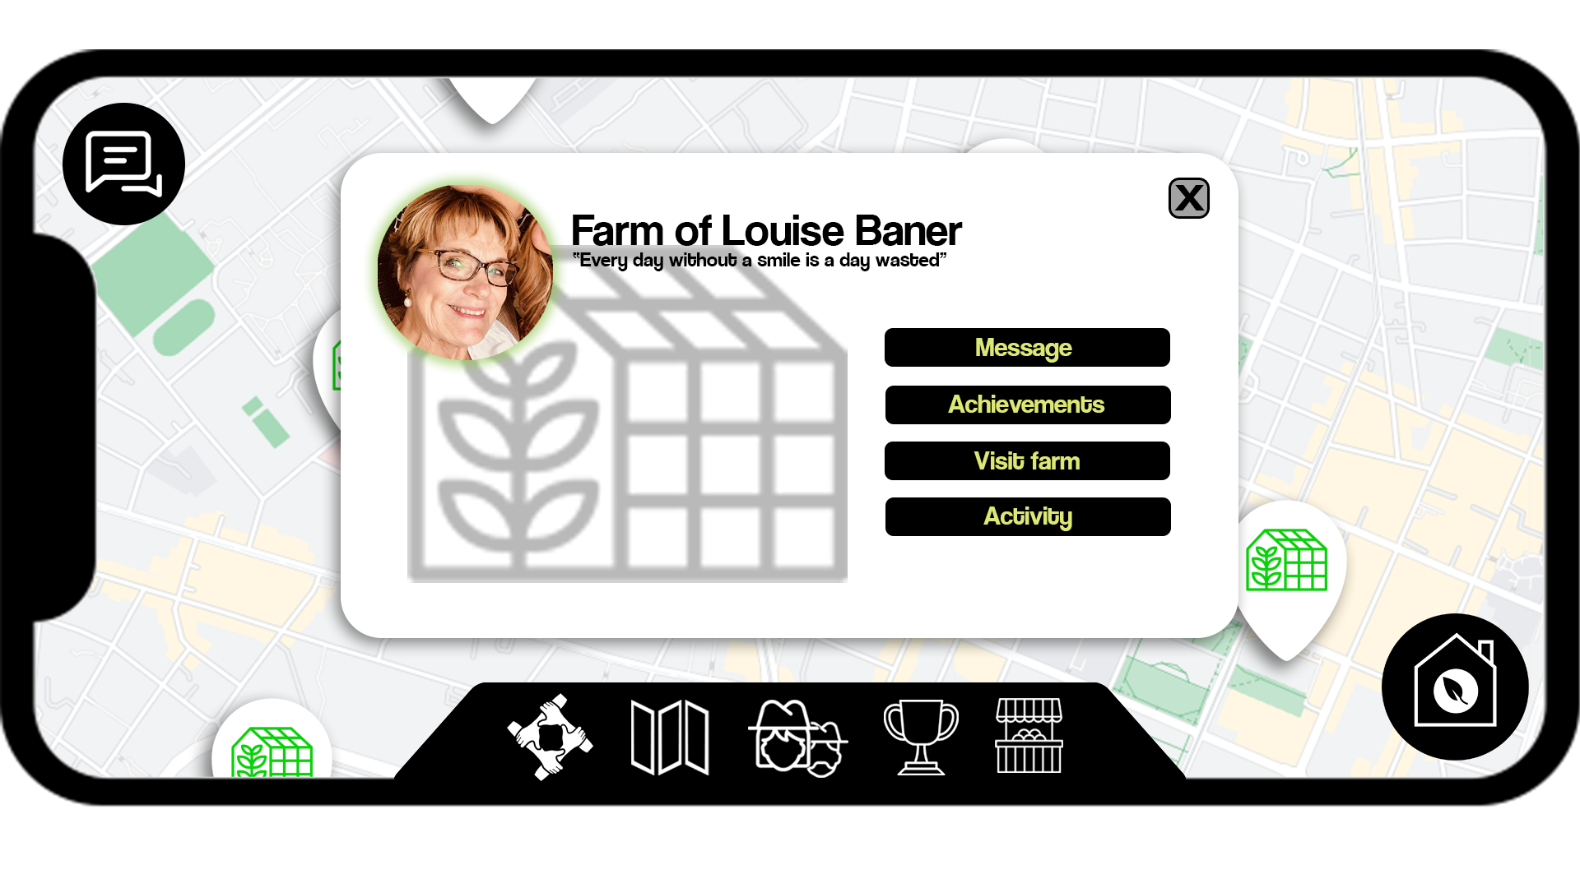
Mixed Reality Experience
2
+
Explore the vast network of ITQs autonomous greenhouses.
Becoming a farmer is now as easy as a click of a button.
Explore the community and visit other farms in your city!

Slide 10
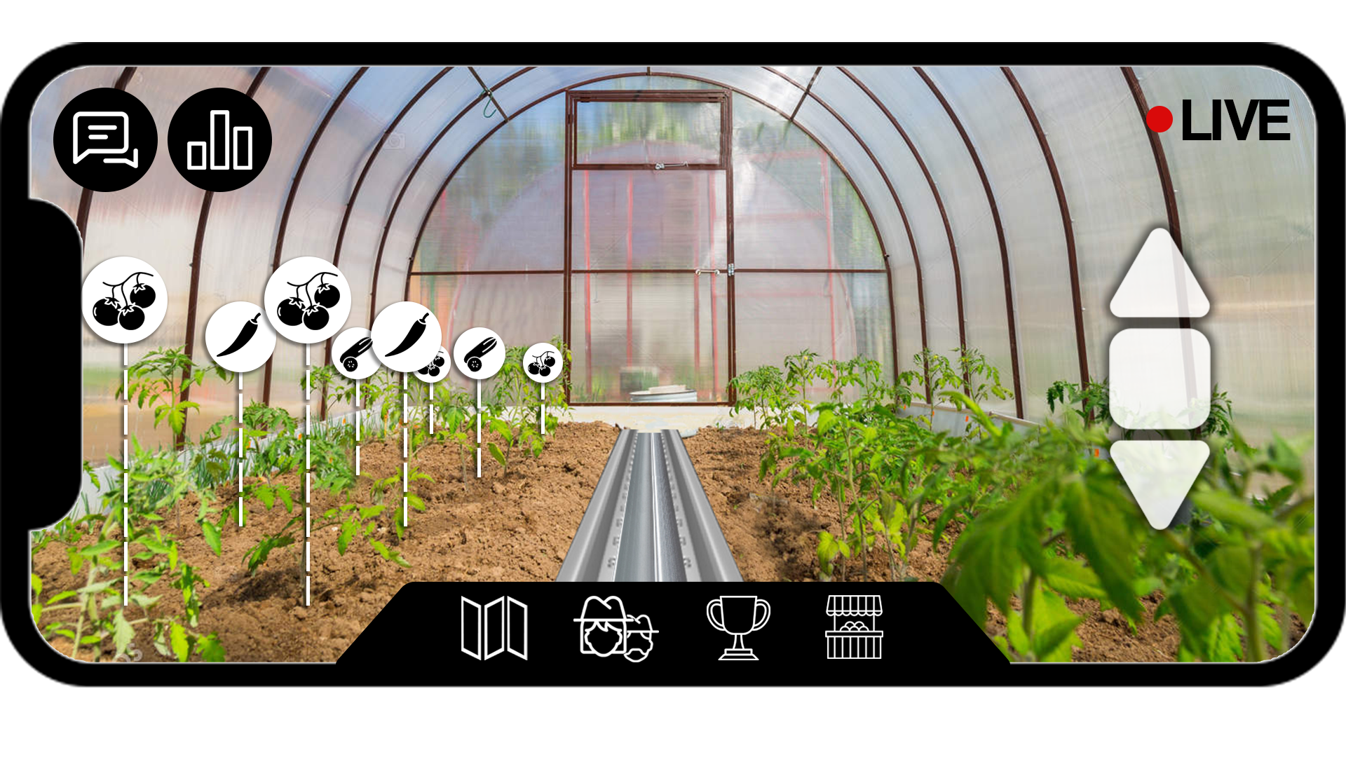
Be a part of the community!
2
+
Personalize your farm: yield, inputs, crops, etc.
Monitor your progress and learn by doing.
Exchange, sell, or share items in the open marketplace

Slide 11
Holistic Solution
2
+
Fun
Safe
Responsible

Slide 12
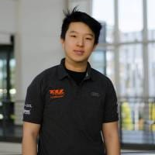
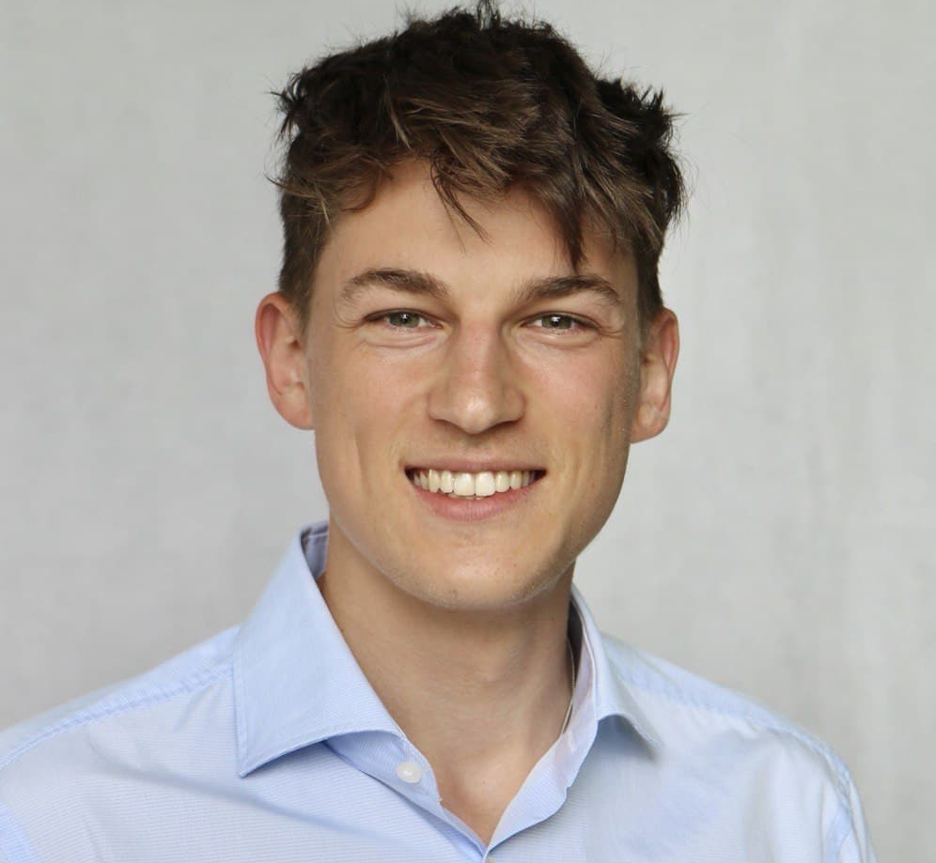
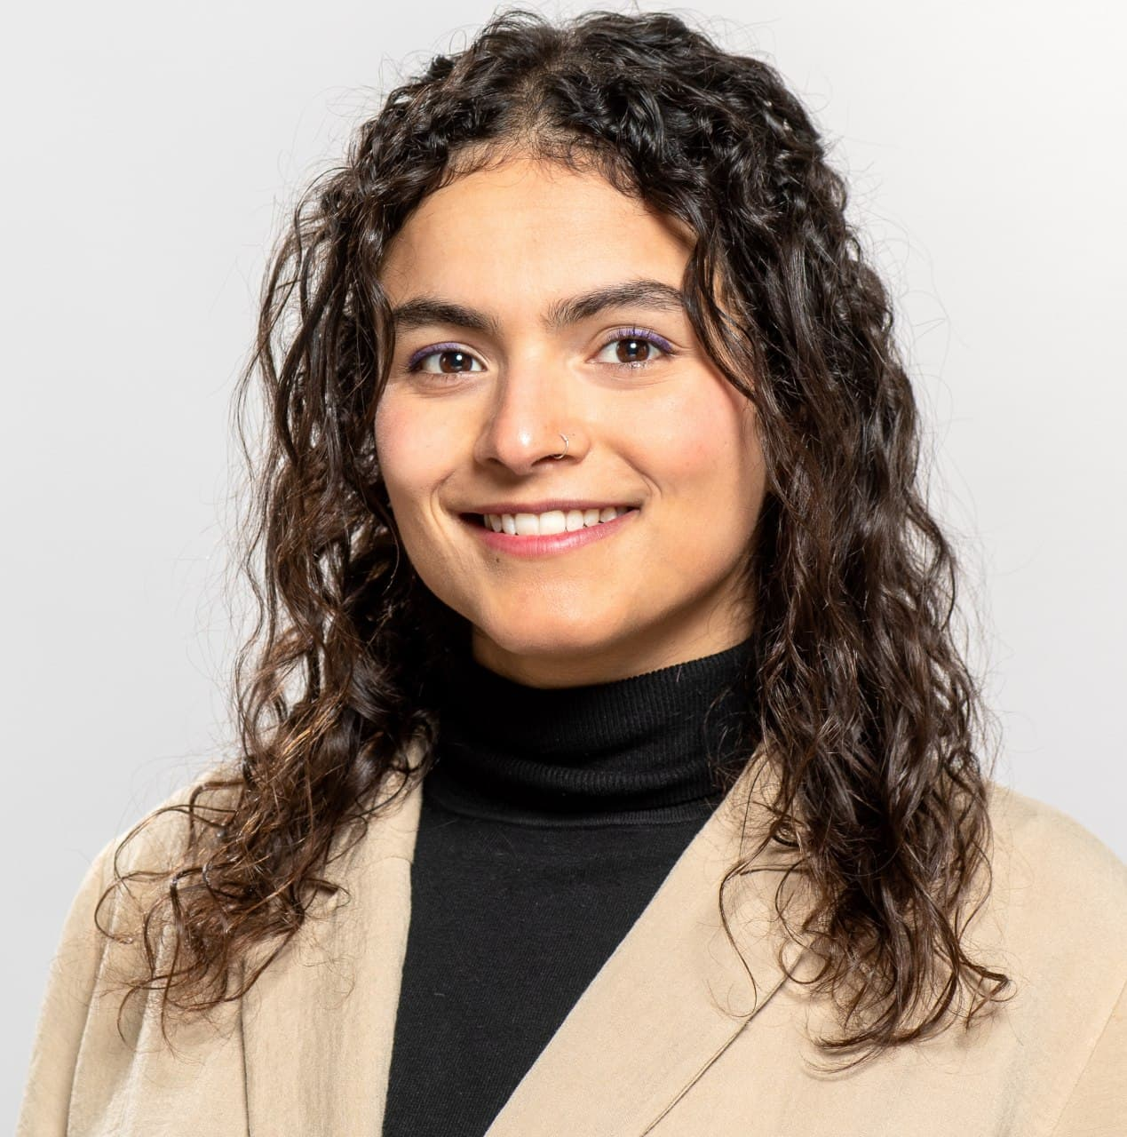
Team
Nick Zhou
Alphin C Tom
Vincent Jansen
Vishnu Sunil
Salma Atalla

Slide 13
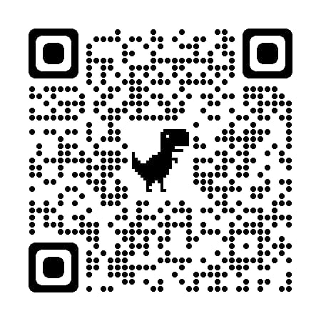
THANK YOU
2
+
2
+
Now watch our app demo!
This Photo by Unknown Author is licensed under CC BY-SA

